Slide 1
Opening a Pharmacy in Toronto
By
Ishaasamyuktha.S

Slide 2
Introduction
Toronto is considered as one of the safest countries in the world. Neighborhoods of Toronto are filled with nightlife, colourful restaurant scene, museum, and art galleries in addition, Toronto provides almost free health services to the people even if you have just moved to Canada. If you have been a resident of Ontario for three months, you are entitled to health care services paid for by the Ontario Health Insurance Plan (OHIP). This provides additional benefits in migrating to Toronto along with good housing prices and reputed schools for children.
This project aims in helping pharmacists in exploring neighborhoods who wants to open a new pharmacy in Toronto area. This project will aid in making smart and effective decision on choosing the better neighbourhood for business development.

Slide 3
Aim and Objective
The major aim of this project, is to suggest a better neighborhood in a new city for an entrepreneur who wants to start a business here. This helps the entrepreneur wanting to start a medical shop or pharmacy here. The competition of that business in different neighborhoods, and which neighbourhood needs a pharmacy in their locality. And the objective can be further extended to knowledge of people are shifting here about medical shops in here neighbourhood.
Target Audience
Budding entrepreneurs who wants to start a pharmacy in a new city.
Canadian immigrants who want to explore and find neighborhoods with better medical facilities.

Slide 4
Data Acquisition
For this project we require the following:
List of neighborhoods in Canada.
The location i.e. Latitude and Longitude of these neighborhoods.
Number of pharmacy/Medical Shops in each neighborhood.
Data Extraction
Using Wikipedia to scrap the data of Toronto city containing boroughs, neighborhoods and postal codes.
Geocoder Package to obtain latitudes and longitudes of these neighborhoods.
Use of Foursquare app to get the venue details regarding medical shops.

Slide 5
Methodology
01
DATA CLEANSING
02
FOURSQUARE API
03
LIBRARIES TO BE IMPORTED
04
K-MEANS CLUSTERING
05
FEATURE EXTRACTION

Slide 6
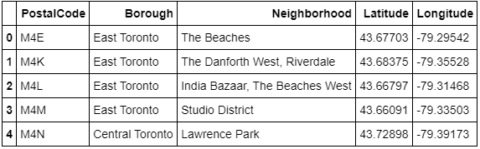
RESULTS AND DISCUSSION
Fig.1: Neighborhoods in Toronto with their Latitude and Longitude Coordinates using Geocoder
Fig.1 shows the how postal codes, boroughs and neighborhoods are scrapped from Wikipedia and made into data frames. Their geographical coordinated are extracted using geocoder.

Slide 7
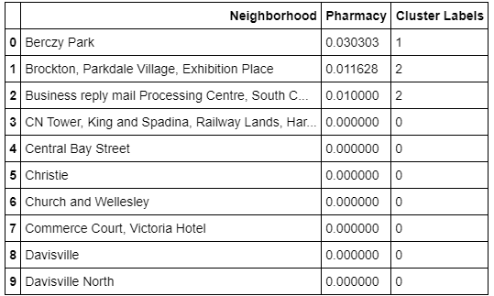
RESULTS AND DISCUSSION
Fig2: Neighborhood segregated into 3 clusters based on their distance from medical shops
The nearby venues are found using Foursquare app for these neighborhoods and classified using unsupervised learning algorithm K-Means to cluster these areas with respect to the distances from pharmacies represented in Fig.2.

Slide 8
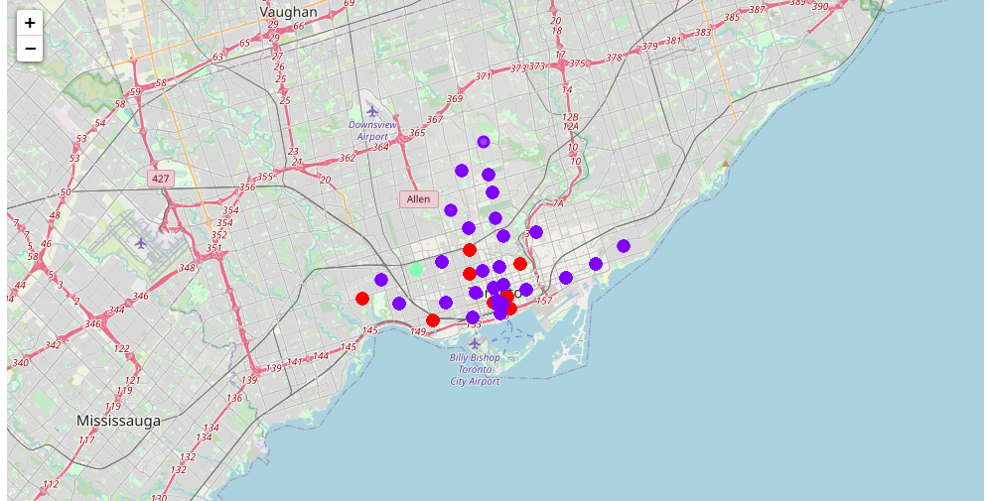
RESULTS AND DISCUSSION
Fig3: Clusters viewed using Folium
The results from K- means clustering is visualized using Folium as seen in Fig.3. Toronto neighborhoods are classified into 3 clusters based on how many pharmacies are in each neighborhood:
Cluster 0: Neighborhoods with no medical shops.
Cluster 1: Neighborhoods with high number of medical shops.
Cluster 2: Neighborhoods with little or no medical shops.
The results are visualized in the above map with Cluster 0 in green colour, Cluster 1 in blue colour and Cluster 2 in red colour.

Slide 9
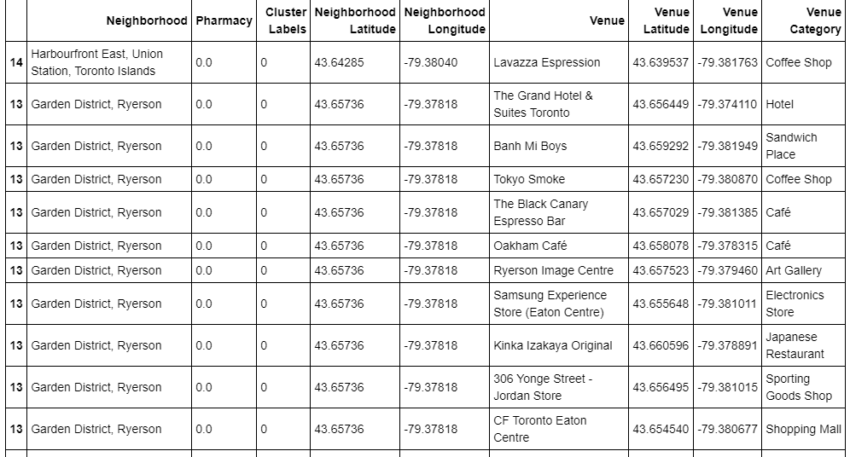
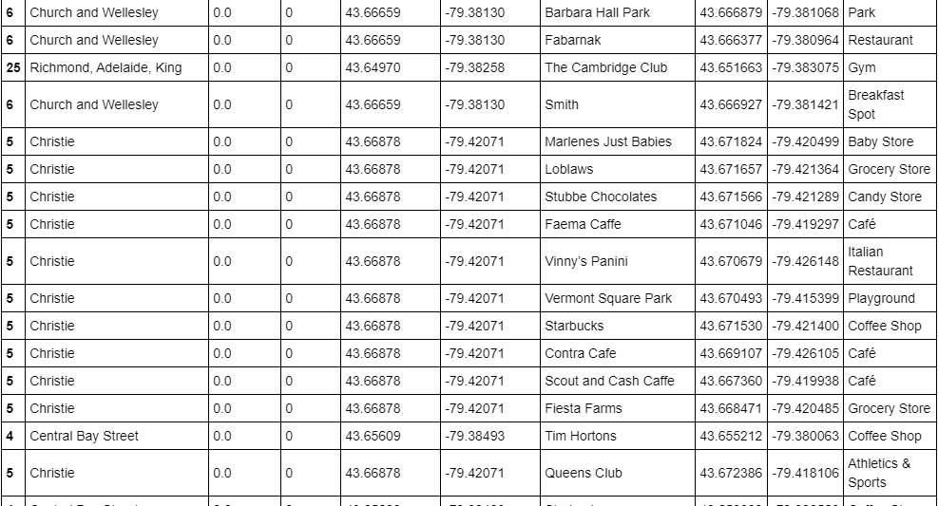
RESULTS AND DISCUSSION
Fig4: Localities in cluster 0

Slide 10
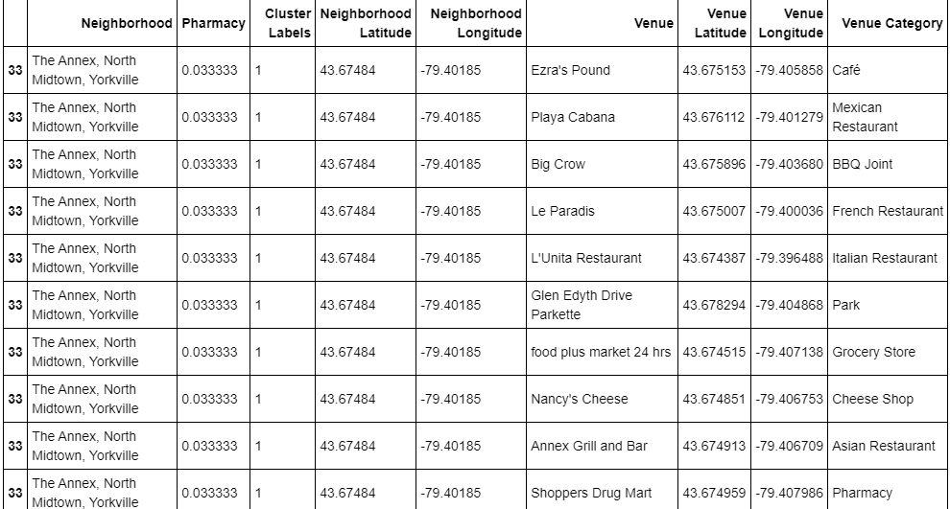
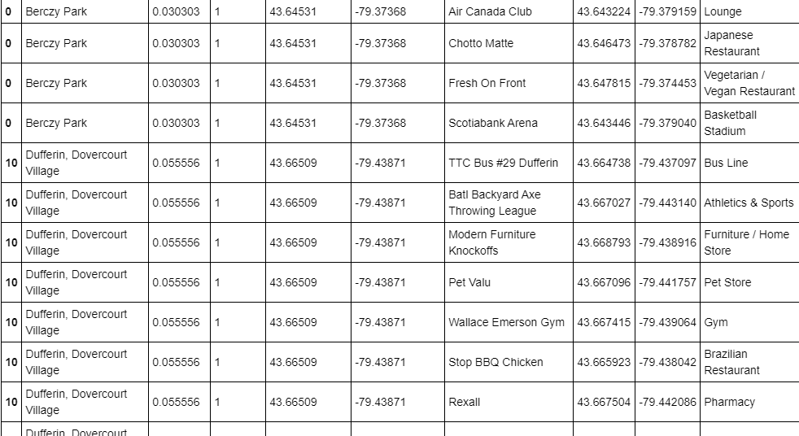
RESULTS AND DISCUSSION
Fig5: Localities in Cluster 1

Slide 11
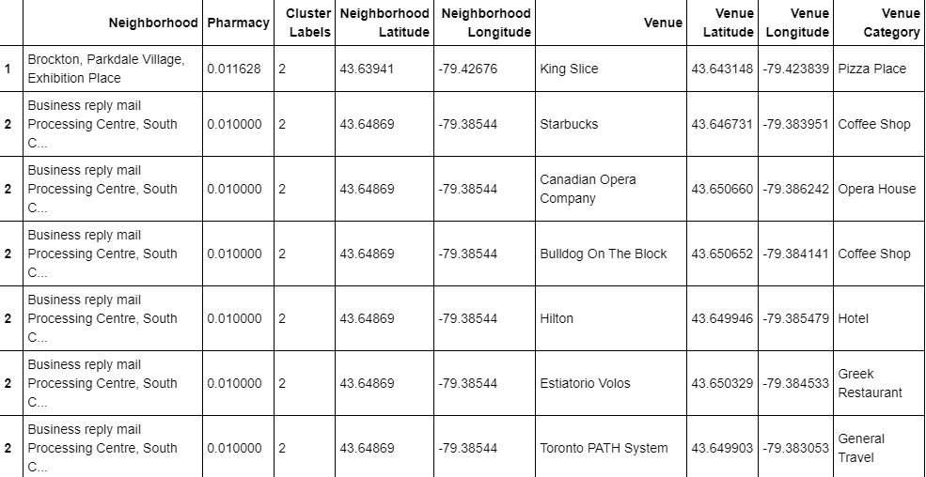
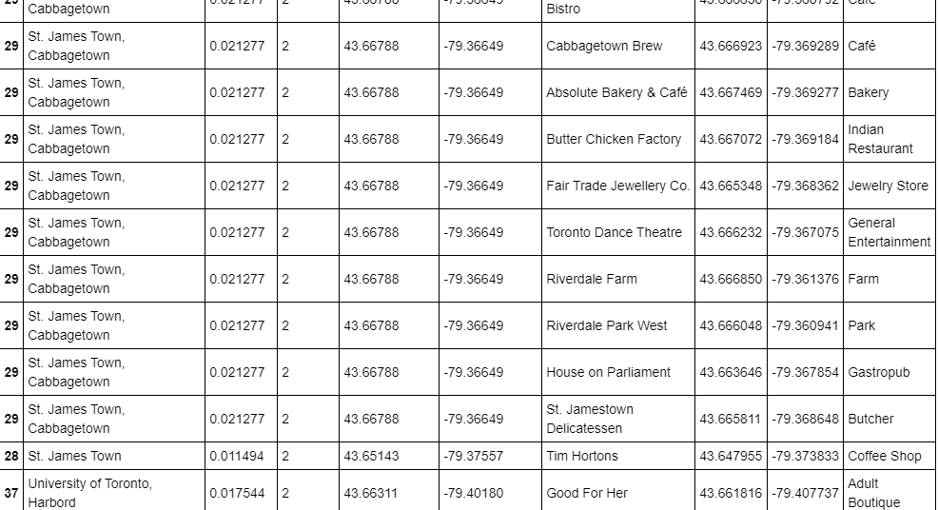
RESULTS AND DISCUSSION
Fig6: Localities in Cluster 2
Fig.4, Fig.5, Fig.6 represents the neighborhoods which fall under the three clusters with no pharmacy, high and little number of pharmacies in Cluster 0,1,2 respectively.

Slide 12
Conclusion
In this project, we have gone through the process of identifying the business problem, specifying the data required, extracting and preparing the data, performing the machine learning by utilizing k-means clustering and providing recommendation to the stakeholder.
Most of Pharmacies are present in Cluster 1 which is around Berczy park, Yorkville, and Dovercourt village areas and lowest (close to zero) in Cluster 0 areas which are Central Bay Street, Reyerson, Richmond, Adelaide, Church and Wellesley. Also, there are good opportunities to open near University of Toronto, St James town as the competition seems to be low. Looking at nearby venues, it seems Cluster 0 might be a good location as there are not a lot of medical shops in these areas. Therefore, this project recommends the entrepreneur to open a Pharmacy in these locations with little to no competition. Nonetheless, if the quality of the medicine, biomedical waste management, hygiene and service and hospitality is good, It is possible that pharmacy will have great following everywhere.

Slide 13
FUTURE WORK
In this project, only one consideration is taken i.e., existence of medical shops in each neighborhood. There are many factors that can be taken into consideration such as population density, income of residents, rent that could influence the decision to open a new pharmacy. Future research can take into consideration of these factors. In addition, future research can take into consideration of other variables such as existence of medical camps, hospitals and health services, accident prone areas which require immediate medical shops for first aid in each neighborhood.

Slide 14
THANK YOU!

